Slide 1
Plasma Diagnostic Techniques Lecture 6
Deborah O’Connell
York Plasma Institute

Slide 2
Electromagnetic waves in plasmas
Lecture 6

Slide 3
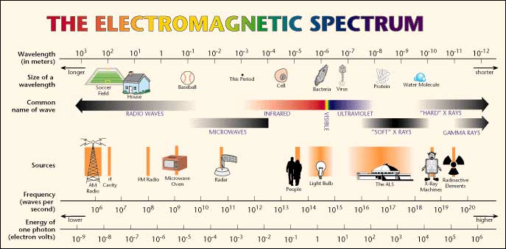
Electromagnetic spectrum: how it is used
DC, AC, kHz, radio-frequency (rf: typically MHz), microwave (GHz): often employed for electrical power input to generate and heat plasmas.
Microwaves, infrared, visible, UV, VUV: often employed for plasma diagnostic techniques.
http://en.wikibooks.org/wiki/ Communication_Systems/Wave_Propagation
Lecture 6

Slide 4
Radiative transfer
Lecture 6

Slide 5
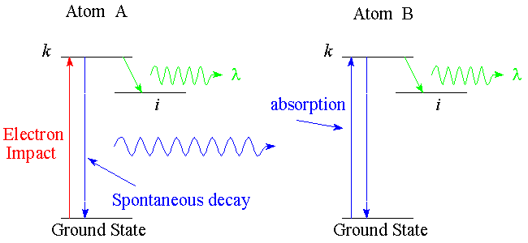
Radiative transfer: example
Reabsorption of emitted radiation can play an important part in radiative transfer – see illustration.
An emitted photon is reabsorbed by a neighbouring atom and subsequently gets a ‘second chance’ to emit radiation through the same or a different transition.
Lecture 6

Slide 6
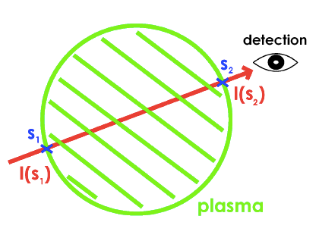
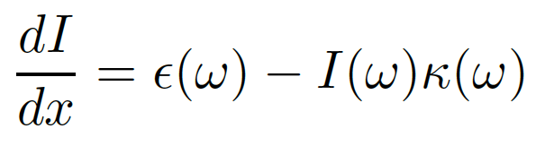
Radiative transfer: concept
In propagating through a medium, the intensity of radiation I(ω), which is the radiative power per unit area, per unit solid angle, per unit angular frequency is given by:
ε(ω): emissivity
κ(ω): absorption coefficient
Lecture 6
Notes:
ω is the frequency of the photon
Emissivity – additional contribution to intensity due to emission (+)
Power radiated per unit solid angle per unit angular frequency.
Absorption – what is absorbed by the media, lost (-)
Change in intensity over the path within the plasma, will depend on the emission and the contribution absorbed (dependent on the absorption coefficient).

Slide 7
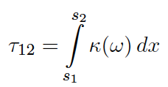
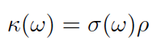
Radiative transfer: definitions
The ‘optical depth’, τ, between two points of a ray is defined by:
The absorption (or ‘extraction') coefficient is related to the ‘opacity' by:
ρ: density of the medium
ε(ω): emissivity
κ(ω): absorption coefficient
Lecture 6
Notes:
The optical depth will be defined as how much has been absorbed on its path (integral over the absorption coefficient)
The absorption coefficient is dependent on the cross-section times the density of the absorbing medium

Slide 8
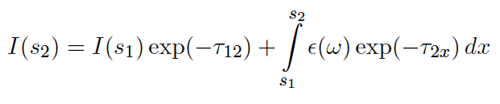
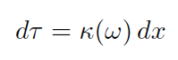
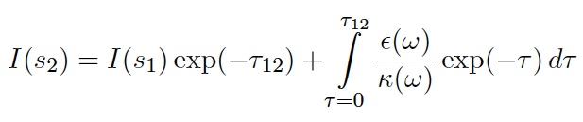
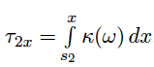
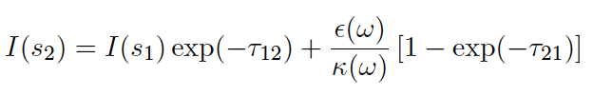
Radiative transfer: integration
Integration of radiative transfer equation:
With
With constant source function ε(ω)/κ(ω):
Not all mathematical details covered in lecture
Lecture 6

Slide 9
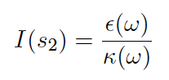
Radiative transfer: integration
Optically thick τ₂₁ >> 1:
Lecture 6
Notes:
Integrate dI/dx to determine the intensity at the detection point.
First term is the original intensity times an exponential decay of the optical depth (dependent on the absorption coefficient, which depends on the density of the absorbing media and the absorption cross-section). – How much of the original intensity is absorbed.
Second term: ratio of emissivity to absorption, times 1 – exponential decay of the optical depth.
Optically thick situation, optical depth is large. Exp(-large) goes to zero, therefore intensity is ratio for emissivity to absorption.
Optically thin – nothing is absorbed, everything gets through. We can also see the I(s2) to zero for simplicity. Second term: expansion 1 – (1 - T) = T, absorption cancels and left with emissivity.

Slide 10
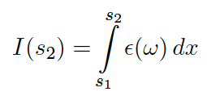
Radiative transfer: integration
Optically thin τ₂₁ << 1, with I(s₁)=0:
Lecture 6
Notes:
Integrate dI/dx to determine the intensity at the detection point.
First term is the original intensity times an exponential decay of the optical depth (dependent on the absorption coefficient, which depends on the density of the absorbing media and the absorption cross-section). – How much of the original intensity is absorbed.
Second term: ratio of emissivity to absorption, times 1 – exponential decay of the optical depth.
Optically thick situation, optical depth is large. Exp(-large) goes to zero, therefore intensity is ratio for emissivity to absorption.
Optically thin – nothing is absorbed, everything gets through. We can also see the I(s2) to zero for simplicity. Second term: expansion 1 – (1 - T) = T, absorption cancels and left with emissivity.

Slide 11
Radiative transfer: example
Reabsorption can be included in the effective decay rate of excited states.
Optically thin: g_{ik}=1
Optically thick: g_{ik}=0
Lecture 6
Notes:
For the case of completely optically thick.
The transition ‘doesn’t exist’ – nothing has happened.

Slide 12
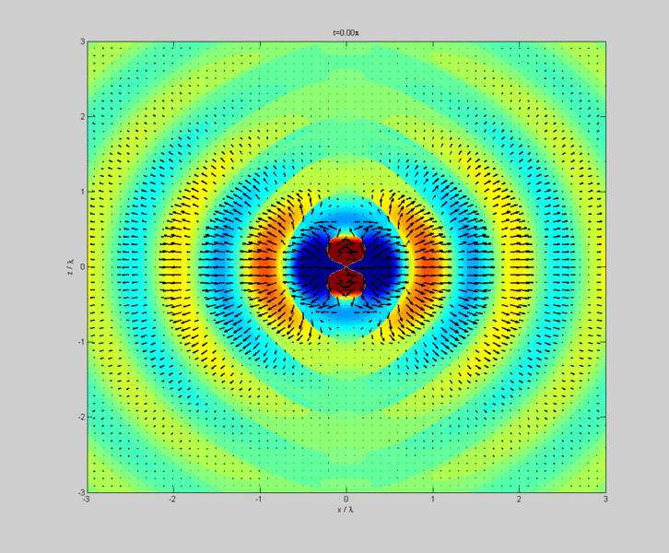
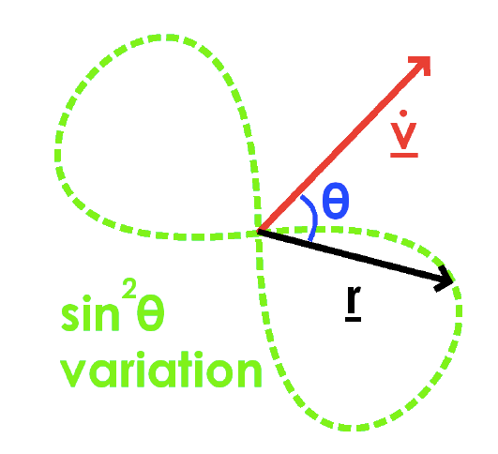
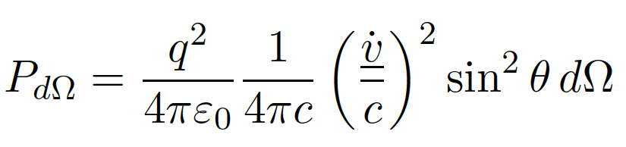
Radiation from accelerated charges
We know from undergraduate electrodynamics that accelerated charges emit radiation.
This is the basis of dipole radiation exploited in antenna technology – see animation.
Lecture 6
Notes:
P – radiative power
Proportional to acceleration (vdot)
Angular dependence, zero radiative power for pi, maximum perpendicular to motion

Slide 13
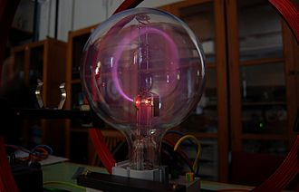
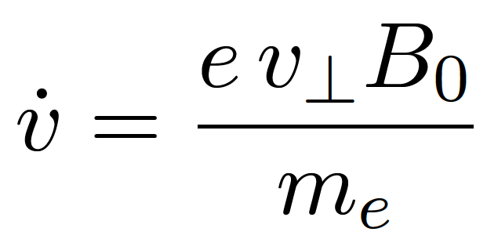
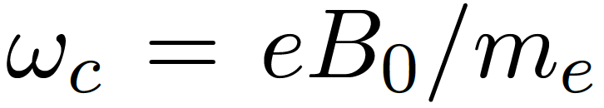
Cyclotron radiation
Electrons with a velocity component perpendicular to a magnetic field are accelerated (Lorentz force) such that:
In a homogenous magnetic field this results in a circular motion, see figure, with the cyclotron frequency:
Lecture 6

Slide 14
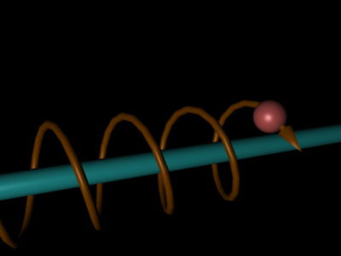
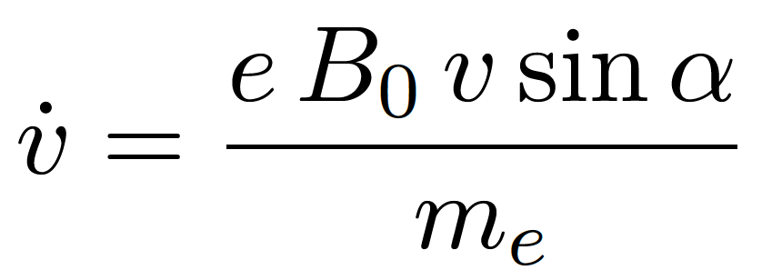
Cyclotron radiation
There is no force in the direction of the magnetic field and the parallel velocity is preserved resulting in a spiral motion – see illustration.
We can use the direction of the magnetic field as a reference frame and following the rules of the vector cross product write:
Lecture 6

Slide 15
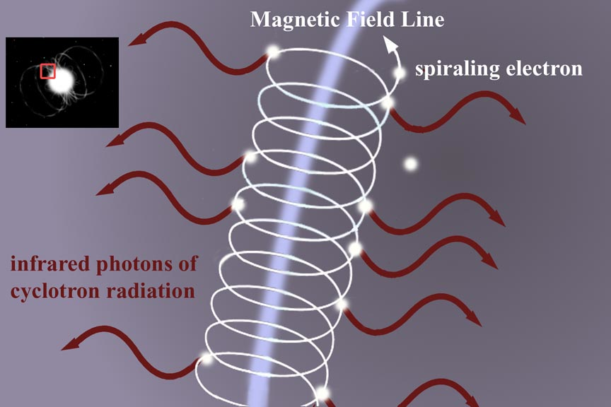
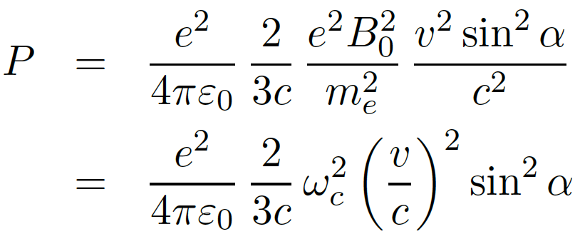
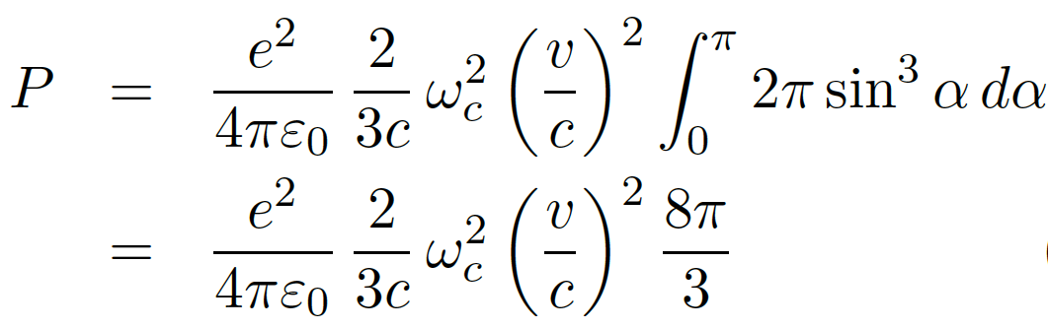
Cyclotron radiation
The cyclotron radiation power is consequently given by:
Assuming an isotropic distribution function, e.g. Maxwellian, we can integrate in space and time obtaining:
Lecture 6

Slide 16
https://www.youtube.com/watch?v=_xv_GwCgpAc
Lecture 6

Slide 17
Bremsstrahlung

Slide 18
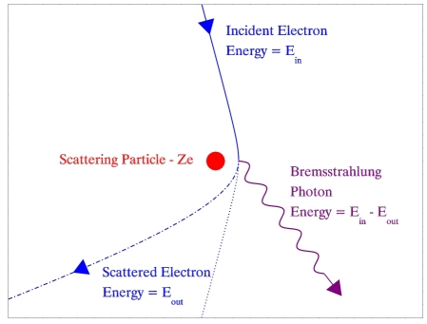
Bremsstrahlung: concept
Bremsstrahlung (German for ‘breaking radiation’) is caused by de-accelerated electrons in the vicinity of ions neglecting inelastic collision processes – see illustration.

Slide 19
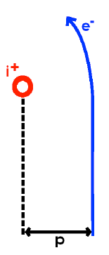
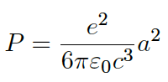
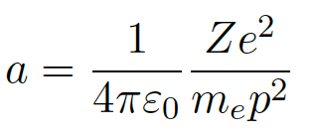
Bremsstrahlung: radiated power
The power P radiated by an electron when de-accelerated is given by:
The acceleration a of an electron in a collision with an ion at the closest point of approach p (see illustration) is given by:
Notes:
P – scatter collision parameter

Slide 20
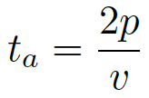
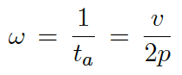
Bremsstrahlung: emitted frequency
For small angle collisions the time over which acceleration occurs can be approximated by:
The Bremsstrahlung pulse lasts for a time t_{a}, and so when Fourier analysed, produces a dominant contribution to that part of the frequency spectrum with:

Slide 21
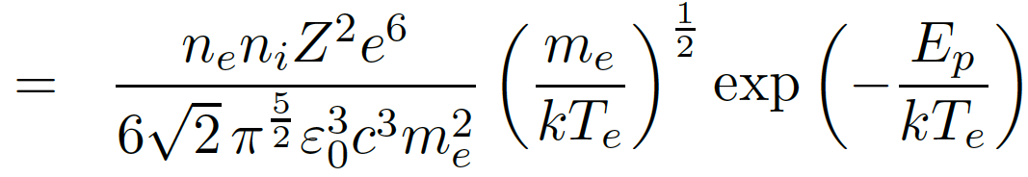
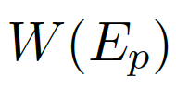
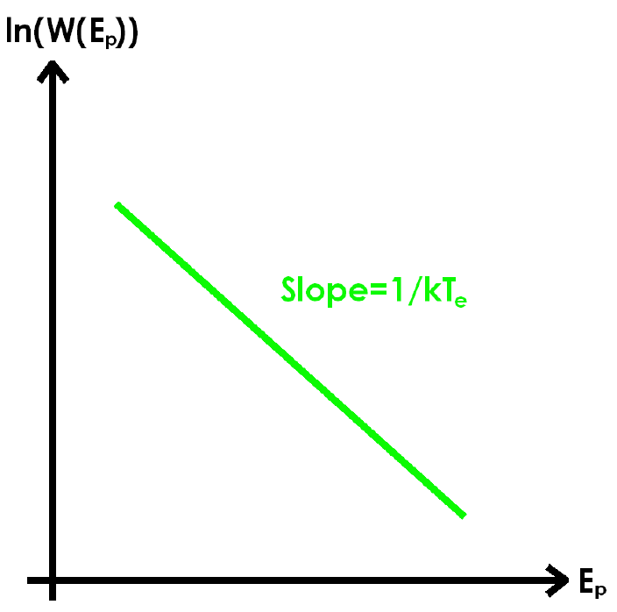
Bremsstrahlung: frequency spectrum
Assuming a Maxwellian distribution function of speeds the total energy radiated W(E_{p}) dE_{p} for a photon energy E_{p} is given by:
Details are complex and this is only a simple ‘classical’ approximation. The general scaling and dependencies, however, also hold in a full quantum mechanical treatment.
The measurement of the frequency spectrum is often employed as a diagnostics technique for the electron temperature – see figure.

Slide 22
Summary
Cyclotron radiation
Accelerated charges emit radiation
Particles undergo acceleration (changing velocity) in magnetic field and can radiate
Basis of synchrotron radiation
Bremsstrahlung
Electron acceleration (& emission) due to scattering in the presence of ions
Bremsstrahlung ‘pulses’ can be translated into a frequency space
Spectrum can be employed as a diagnostic of electron temperature

